Slide 1
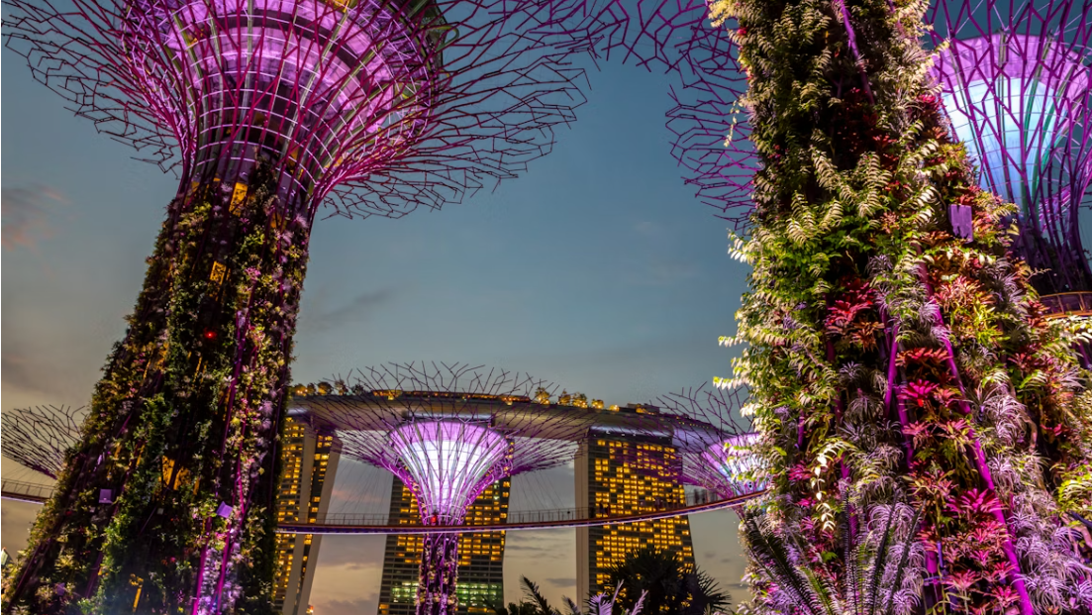
Gardens by the Bay
Dialogflow Chatbot
Name: Ong Jin Sheng
Student ID: 9252802J
Class: SP-IT8303 AI – Human Interface

Slide 2
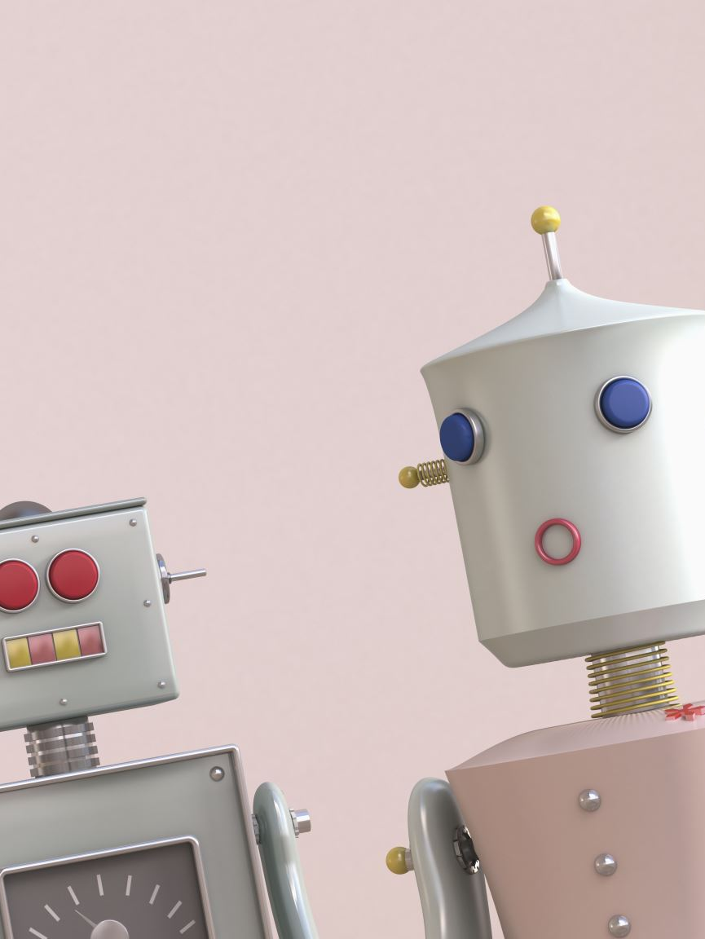
Chatbot Overview & Integration
Name: Gardenbtb_bot
Description: A friendly virtual assistant designed to help visitors plan their trip to Gardens by the Bay. The bot provides information on ticket prices, attractions, directions, opening hours, and dining options through natural conversation.
Working Integration:
Platform: Telegram
URL: t.me/Gardenbtb_bot

Slide 3
Summary of Intents
Core Domain Intents
(Total :15)
Ticketing (6)
Attractions (2)
Amenities (2)
Directions (2)
Dine & Shop (2)
Opening Hours (1)
FAQs (1)
Small Talk Intents (Total: 3)
Greetings
Thank you
Goodbye
Fallback Intents
(Total :2)
Default fallback intents
Contact us
Total intents = 21
Comments:
For certain domain intents e.g. ticketing, they have several branches with shorter responses to accommodate user’s queries.
Attractions have ticket follow up intent linked to ticketing to allow users to purchase tickets.
Dine & shop and Amenities also have follow up intents to manage potential questions; e.g. a contact us intent which allows users to contact the gardens directly if they need personal assistance.

Slide 4
Entities & Parameters
Custom entities | Parameter Name | Reference values | Example of Synonyms used
@attractions | Attraction | $attractions: Flower Dome, Cloud Forest, SuperTree, Ocbc Skyway | Cloud forest, waterfall, SuperTree, Observatory, skyway
@amenities | Amenities | $amenities: amenities | Getting around, washrooms, wheelchairs, tours, nursing rooms
@contact_us | Contact | $contact_us: Help | Help, contact, get in touch, speak, number, human
Total entities = 3

Slide 5
Rich Message Response
Implementation: Custom Payload (Telegram / Default)
📸
Photo Messages
Attractive images of Gardens attractions
🔘
Interactive Buttons
- Quick action buttons for booking tickets
- Follow up links for what to eat or how to get there
🔗
URL Integration
Direct links to official booking pages e.g. Maps, Amenities & Services
Example: When users ask about a specific attraction e.g. Flower Dome, the bot responds with a short description,
an image and a 'Book Tickets' button linking directly to the official ticketing page.

Slide 6
Sample Training Sentences
Attractions
Where can I buy tickets for Super trees
Tickets and bookings
I like to purchase tickets
How much are tickets
Show me @attraction pricing
Flower dome prices
How to Get there
What’s the address
Directions
How do I get there?
Shop & Dine
Where can I find something to eat?
Food options
Is there a cafe

Slide 7
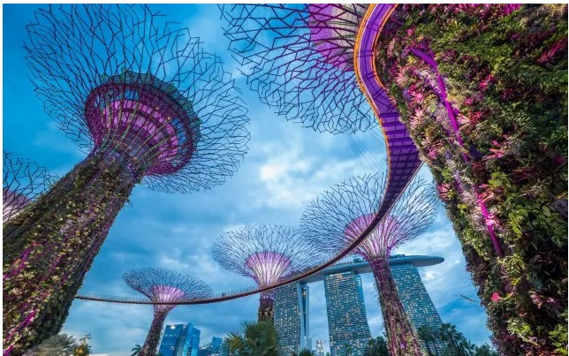
End of Report

